Slide 1
De Pere Aquatic Presentation

Slide 2
Main Question:
What direction does the City want to go to address the aging pools it currently owns and operates?

Slide 3
Agenda
Summary/Background of issue
Current Pools and condition
Other Pools/Aquatics
Options
Question and Answer period

Slide 4
Summary/Background
City owns and operates two outdoor pools
  VFW Pool
    Located on the west side at 730 Grant Street
  Legion Pool
    Located on the east side at 1212 Charles Street

Slide 5
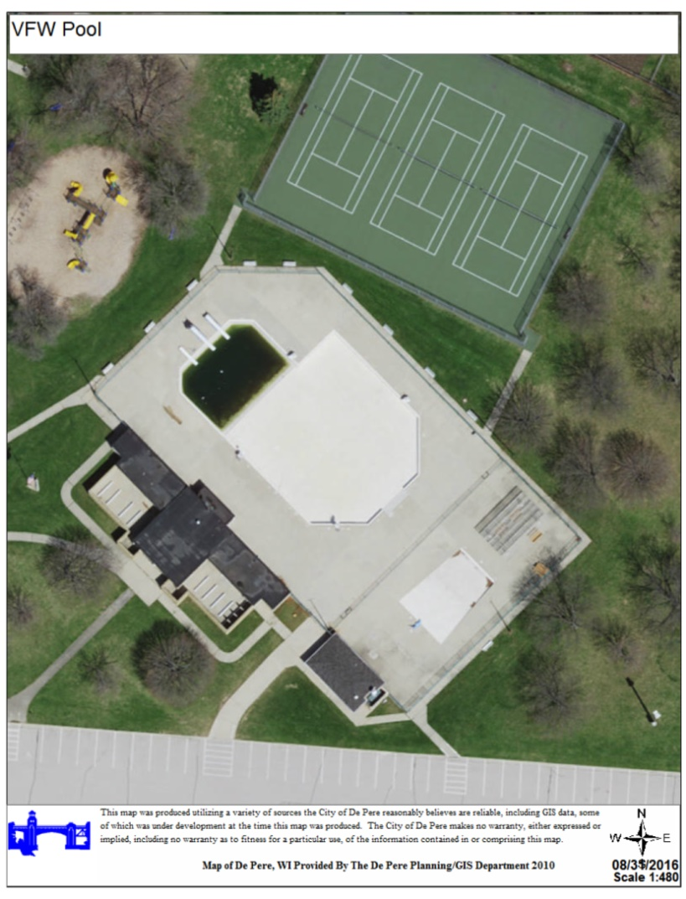
VFW Pool
Facility and main pool constructed in 1957
Remodeled in 1987
Amenities include diving boards (3), wading pool, open air changing rooms, and showers.
Main Pool – 309,000 gallons, Capacity – 637 patrons
Baby Pool – 3,800 gallons, Capacity – 74 patrons

Slide 6
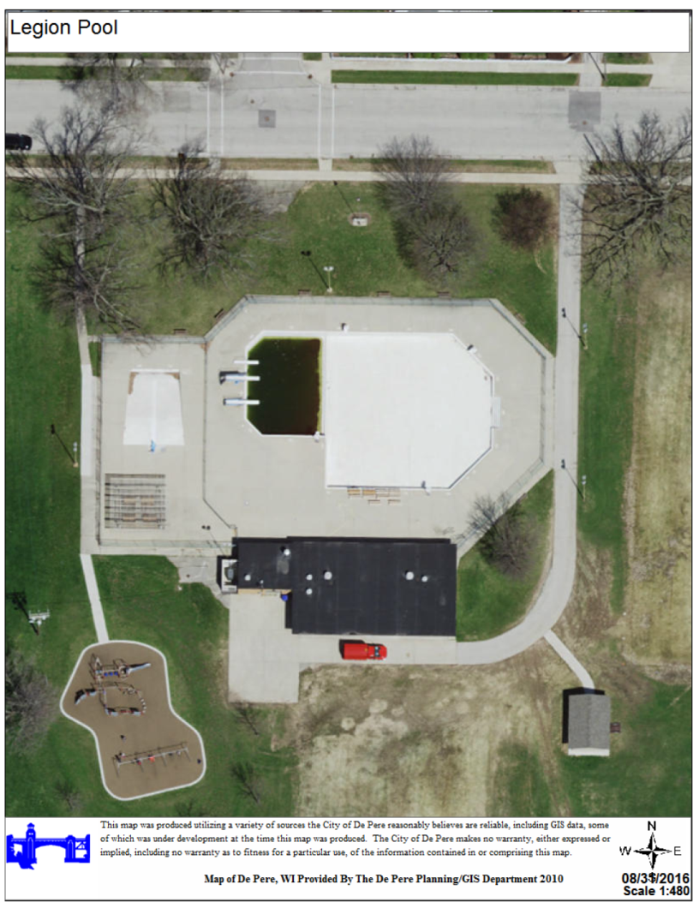
Legion Pool
Facility and main pool constructed in 1961.
Remodeled in 1987.
Amenities include diving boards (3), wading pool, changing rooms, and showers.
Main Pool – 309,000 gallons, Capacity – 647 patrons
Baby Pool – 3,800 gallons, Capacity – 74 patrons

Slide 7
Timeline of Events
July 2012 – ADA Audit completed for all parks and facilities by Cedar Corporation
May 2014 - City hired MSA Professional Services in 2014 to evaluate the conditions of our pools.
October 2014 – MSA submitted Aquatics Facility Evaluation report.

Slide 8
Timeline of Events
January 2015 – Park Board reviewed and considered long term strategy for pools.
  Decision was made to investigate replacing two pools with one aquatic center as an alternative.
  This decision was simply to investigate and was not an indication of the Park Boards final decision in how to address the replacement of our pools.

Slide 9
Timeline of Events
February 2016 - The City hired Vierbecher and Associates to conduct a location study for an aquatic center.
April 2016 - Survey sent out to residents regarding Aquatic Study.
May 2016 – Conducted a Public Informational meeting regarding study
August 2016 – Final report

Slide 10
CURRENT STATUS OF POOLS
Aquatic Facility Evaluation
List of major repairs/maintenance
Annual Report
  Attendance
  Expense/Revenue

Slide 11
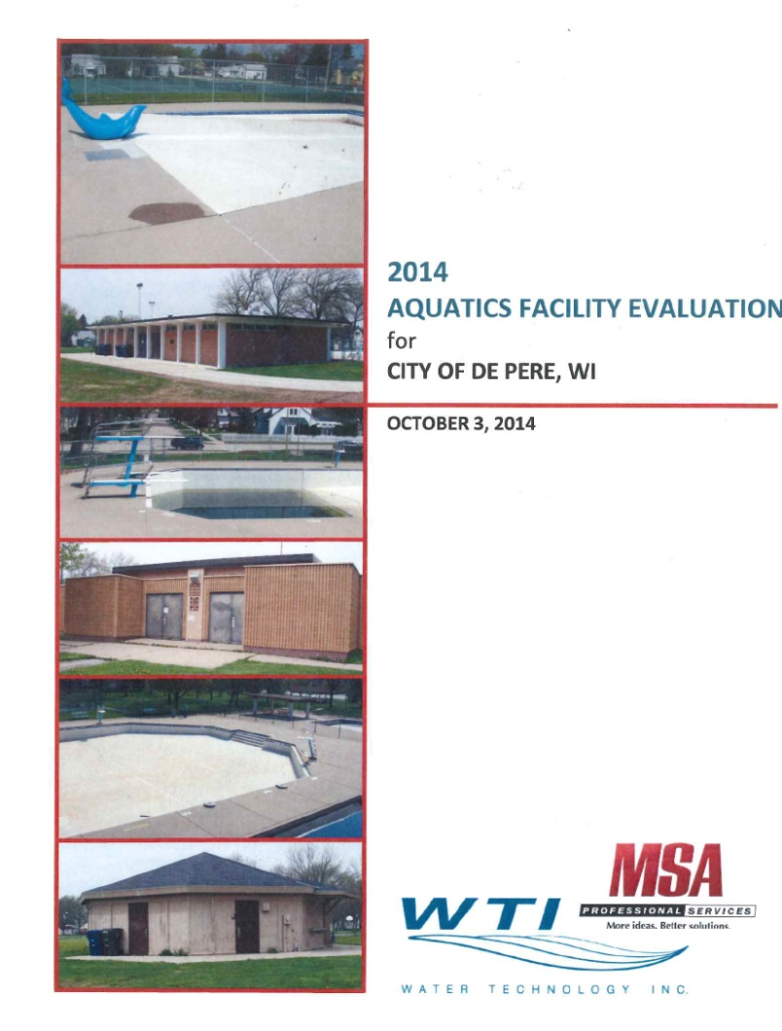
Aquatic Facility Evaluation
Aquatic Facility Evaluation completed in October 2014.
  Condition assessment of both pools
  Provided recommendations

Slide 12
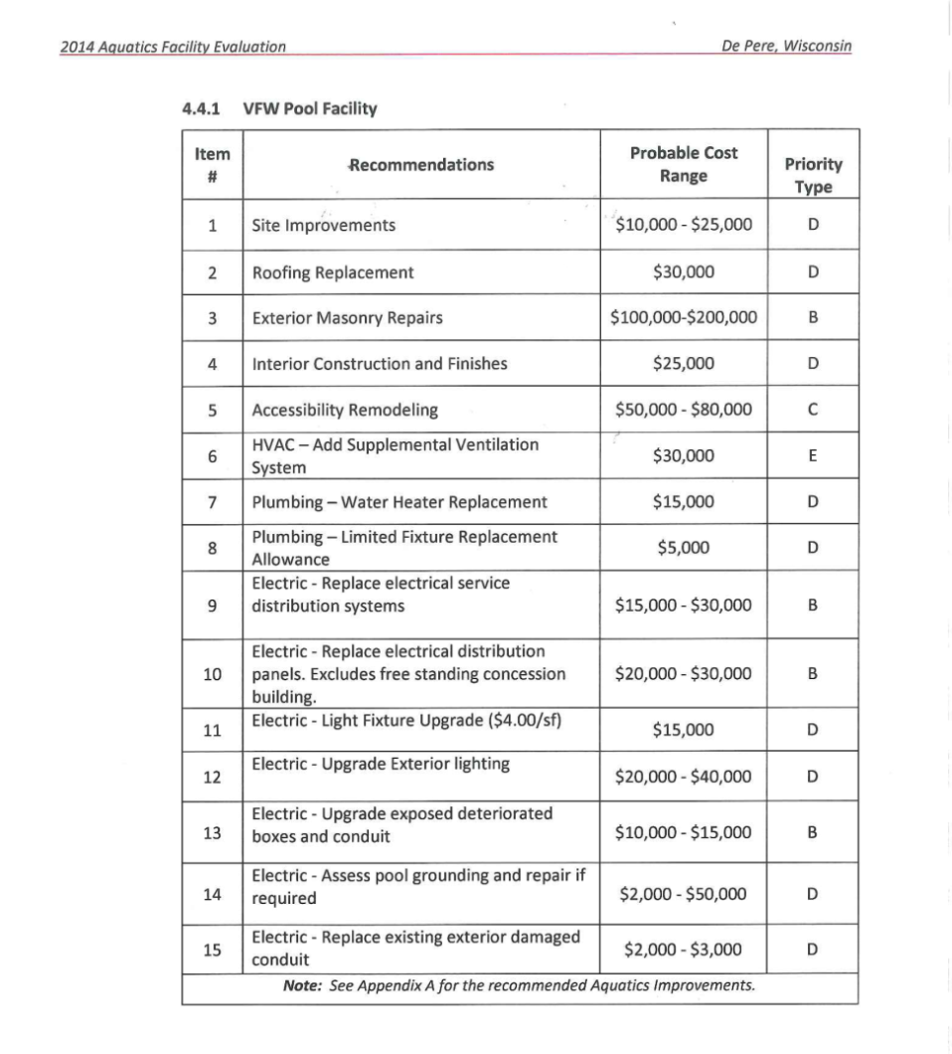
Aquatic Facility Evaluation
VFW Pool
  Generalized costs for repairs.
    $349,000 - $598,000

Slide 13
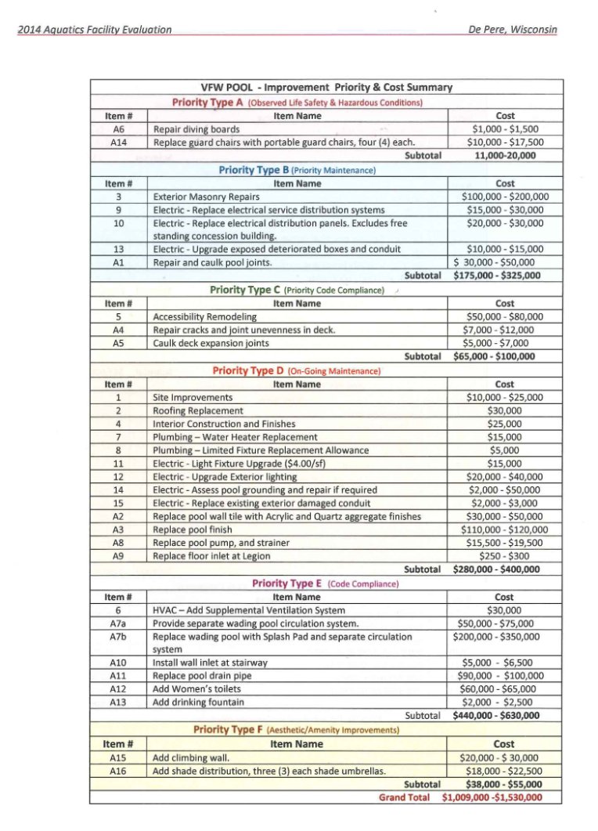
Aquatic Facility Evaluation
VFW Pool upgrade costs
  Detailed cost of repairs and improvements.
  $1 - $1.5 million

Slide 14
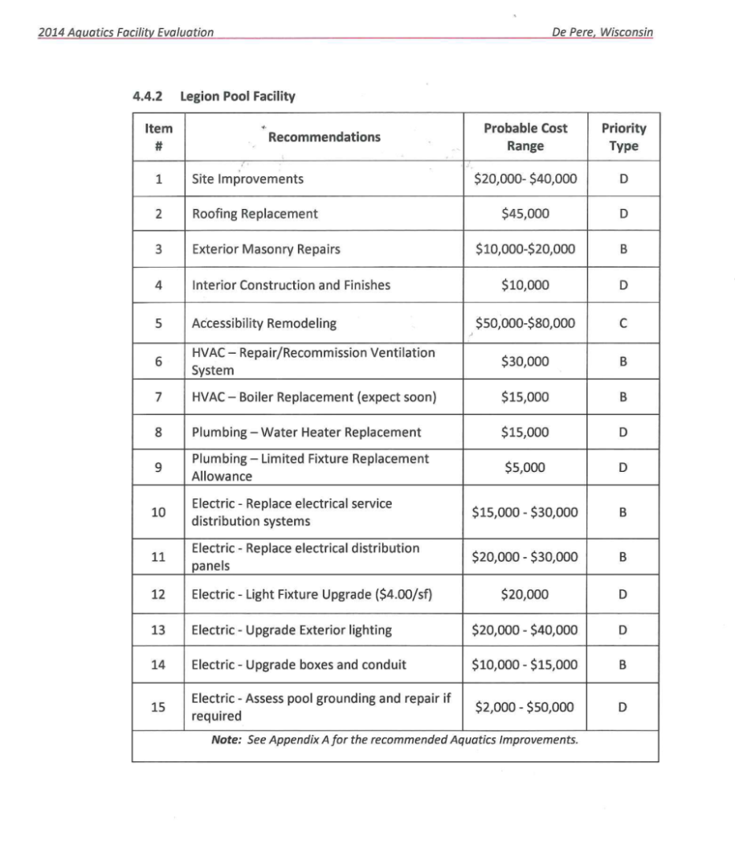
Aquatic Facility Evaluation
Legion Pool
  Generalized costs for repairs.
    $287,000 - $450,000

Slide 15
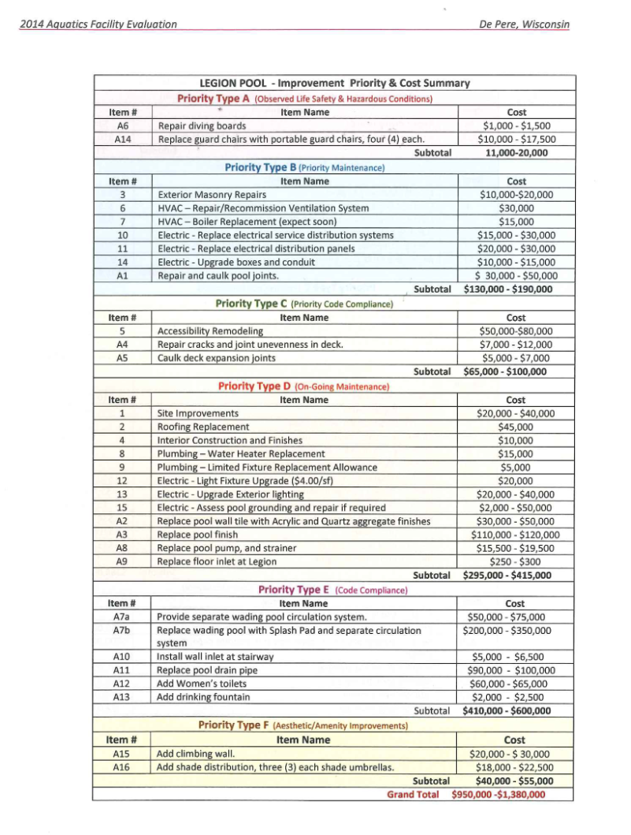
Aquatic Facility Evaluation
Legion Pool upgrade costs
  Detailed cost of repairs and improvements.
  $1 - $1.4 million

Slide 16
Aquatic Facility Evaluation
Recommendations from Aquatic Facility Evaluation
  Did not provide one recommendation, but provided three options.
    Option 1 – Keep both pools and maintain status quo. Looking at $500,000 - $600,000/pool to maintain status quo.
    Option 2 – Build two new facilities (Estimate of $4.5 million per facility)
    Option 3 – Build one Aquatic Facility and maintain one current pool. ($4.5 million for new Aquatic Facility and $500,000-$600,000 for remodel)

Slide 17
Major Repairs and Maintenance
Maintenance Issues
  2016
    VFW - Broken water lateral underneath building. ($15,000)
    VFW – Broken piping in Wading Pool ($5,000 estimated)
    VFW and Legion Main Pool - basin caulking and patching ($9,500)
    VFW and Legion Pools – replaced sand in filters ($11,000)
    VFW and Legion (Current issue)(Diving Boards $15,000-$30,000)

Slide 18
Major Repairs and Maintenance
Maintenance Issues
  2015
    Legion – Dolphin replacement ($2,300)
    VFW – Roof repair ($1,860)
    Legion – Water storage tank ($3,300)
    Legion – Wading Pool repair (Time and materials)
    Legion/VFW – Replace Lifeguard Chairs (10,975)

Slide 19
Major Repairs and Maintenance
Maintenance Issues
  2014
    VFW/Legion – Fencing repair ($1,392)
  2013
    Legion Pool – Wading Pool repair ($15,000)
  2012
    ADA Audit identifies various concerns with building and routes

Slide 20
De Pere Aquatic Annual Report
Attendance
Expense/Revenue

Slide 21

De Pere Pool Attendance
Pool | 2012 | 2013 | 2014 | 2015 | 2016
Legion | 23,010 | 15,953 | 13,053 | 12,031 | 17,643
VFW | 15,241 | 11,811 | 10,520 | 12,463 | 12,235

Slide 22

De Pere Swim Lessons
Pool | 2012 | 2013 | 2014 | 2015 | 2016
Legion/VFW | 741 | 737 | 720 | 684 | 714

Slide 23
De Pere Aquatic Budget

Slide 24
De Pere Aquatic Budget
Expense – Operating/Capital
Revenues
Year | Amount
2012 | $241,353
2013 | $267,681
2014 | $241,239
2015 | $255,990
2016 | $241,563 (YTD)
Year | Amount
2012 | $102,843
2013 | $88,622
2014 | $87,998
2015 | $99,060
2016 | $106,098

Slide 25
Other Pools/Aquatics
Neenah
Appleton
Sparta
Onalaska

Slide 26
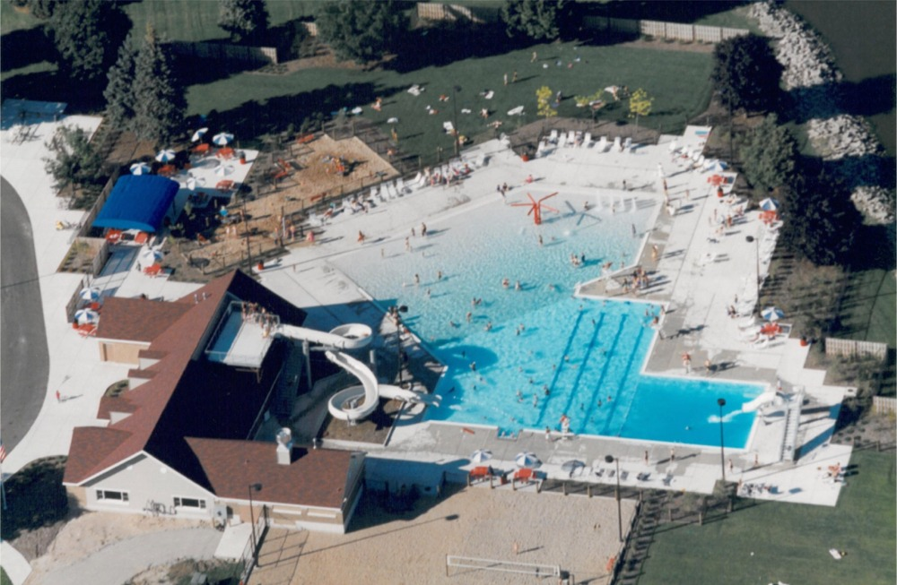
Neenah
Population – 25,855
One Pool
Pool Information
  Opened in 1997
  271,390 gallons
  Bather Capacity 699
  Zero depth entry
  Lap lanes
  22 ft drop slide
  146 ft flume water slide
  Water play features
  Concession
  Tot sand play area
  Grass area

Slide 27
Neenah Pool
Expenses
Revenues
Year | Amount
2016 | $239,360
2015 | $241,191
2014 | $221,528
Year | Amount
2016 | $212,290
2015 | $206,437
2014 | $175,757
Attendance
2012 | 2013 | 2014 | 2015 | 2016
56,325 | 49,371 | 44,759 | 49,973 | 53,099

Slide 28
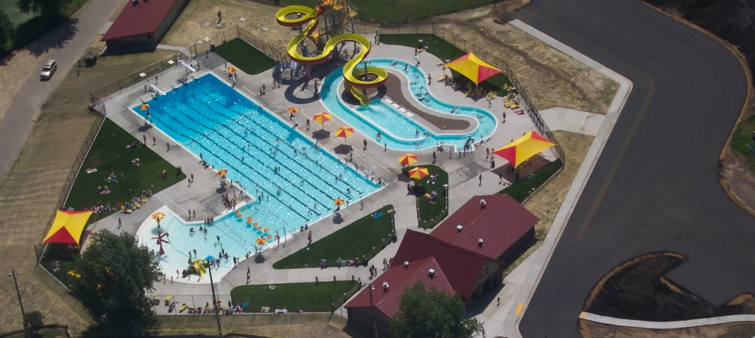
Sparta
Population – 9,500
One pool
Pool Information
  Renovated in 2014
  435,000 gallons
  Zero depth entry
  Lap lanes
  Lazy River
  290 ft Water slide
  Concessions

Slide 29
Sparta
Expenses
Revenues
Year | Amount
2016 | $139,269 est
2015 | $171,469
2014 | $151,305
Year | Amount
2016 | $157,000 est
2015 | $169,850
2014 | $68,996
Attendance
2014 | 2015 | 2016
13,000 (est) | 23,914 | 22,000

Slide 30
Appleton
Population – 72,623
Two pools (Erb and Mead)
Mead Pool – constructed in 1993
Erb Pool – Renovated in 2016

Slide 31
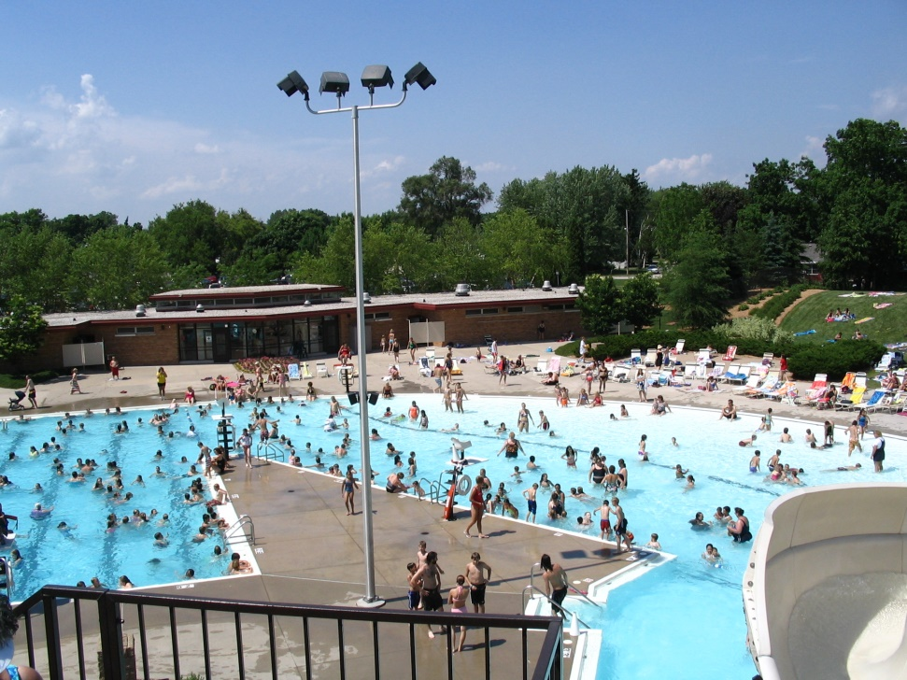
Appleton – Mead Pool
Constructed in 1993
346,133 gallons
Zero depth entry
Lap lanes
159 ft Water slide
Diving boards
Play features
Sand play area
Concessions

Slide 32
Appleton – Mead Pool
Expenses
Revenue
Year | Expenses
2015 | $167,380
2014 | $154,925
Year | Revenue
2015 | $126,679
2014 | $113,490
Attendance
2012 | 2013 | 2014 | 2015 | 2016
52,510 | 44,240 | 48,124 | 49,896 | 44,713

Slide 33
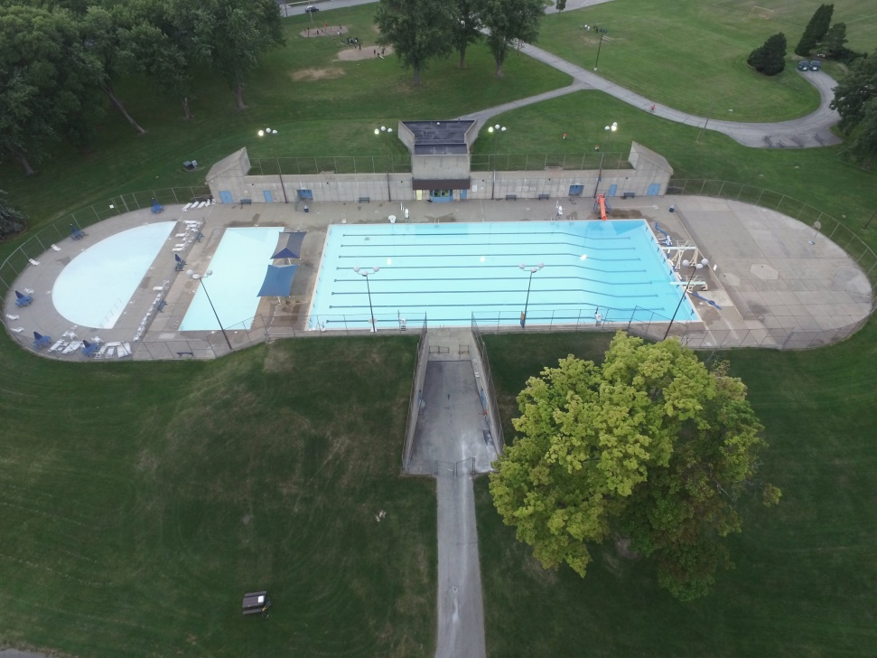
Appleton – Erb Pool
Constructed in 1977
520,000 gallons main pool
49,950 gallons for training and wading pools
Diving boards
Lap lanes
Wading pool
Training pool

Slide 34
Appleton – Erb Pool
Expenses
Revenues
Year | Expense
2015 | $144,955
2014 | $136,947
Year | Revenue
2015 | $67,634
2014 | $63,403
Attendance
2012 | 2013 | 2014 | 2015 | 2016
24,111 | 18,194 | 16,388 | 19,628 | 20,247

Slide 35
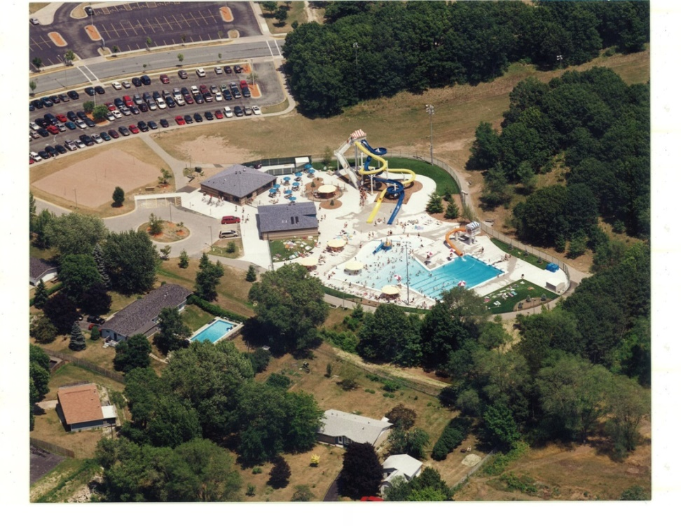
Onalaska
Constructed in 2005
Population – 17,736
One pool
270,000 gallons
Zero depth entry
Drop Slide
Run out slides
Lap lanes
Diving board
Concessions
Sand play area

Slide 36
Onalaska
Expenses
Revenues
Year | Expenses
2016 | $169,000
2015 | NA
2014 | NA
Year | Revenues
2016 | $143,000
2015 | NA
2014 | NA
Attendance
2012 | 2013 | 2014 | 2015 | 2016
22,438 | 18,763 | 16,397 | 18,132 | 18,152

Slide 37
Misc Background Information
Attendance Comparison
Budget Comparison
Location map of pool/aquatic centers

Slide 38
Attendance Comparison
2014
2015
Pool | Attendance
De Pere –Legion | 13,053
De Pere-VFW | 10,520
Sparta (Box) | 13,000
Neenah (AC) | 44,759
Appleton-Mead (AC) | 48,124
Appleton-Erb (Box) | 16,388
Onalaska (AC) | 16,397
Pool | Attendance
De Pere-Legion | 12,031
De Pere-VFW | 12,463
Sparta (AC) | 23,914
Neenah (AC) | 49,973
Appleton-Mead (AC) | 49,896
Appleton-Erb (Box) | 19,628
Onalaska (AC) | 18,132

Slide 39
Budget Comparison
2015
Pool | Expense | Revenue | +/-
De Pere - Legion/VFW (Box) | $255,990 | $99,060 | ($156,930) ($78,469/pool)
Sparta (AC) | $171,469 | $169,850 | ($1,619)
Neenah (AC) | $241,191 | $206,437 | ($34,754)
Appleton – Mead (AC) | $167,380 | $126,679 | ($40,701)
Appleton – Erb (Box) | $144,955 | $67,634 | ($77,321)

Slide 40
Budget comparison
2014
Pool | Expense | Revenue | +/-
De Pere – Legion/VFW (Box) | $241,239 | $87,997 | ($153,242) ($76,621/pool)
Sparta (Box) | $151,305 | $68,996 | ($82,309)
Neenah (AC) | $221,528 | $175,757 | ($45,771)
Appleton – Mead (AC) | $154,925 | $113,490 | ($41,435)
Appleton – Erb (Box) | $136,947 | $63,403 | ($73,544)

Slide 41
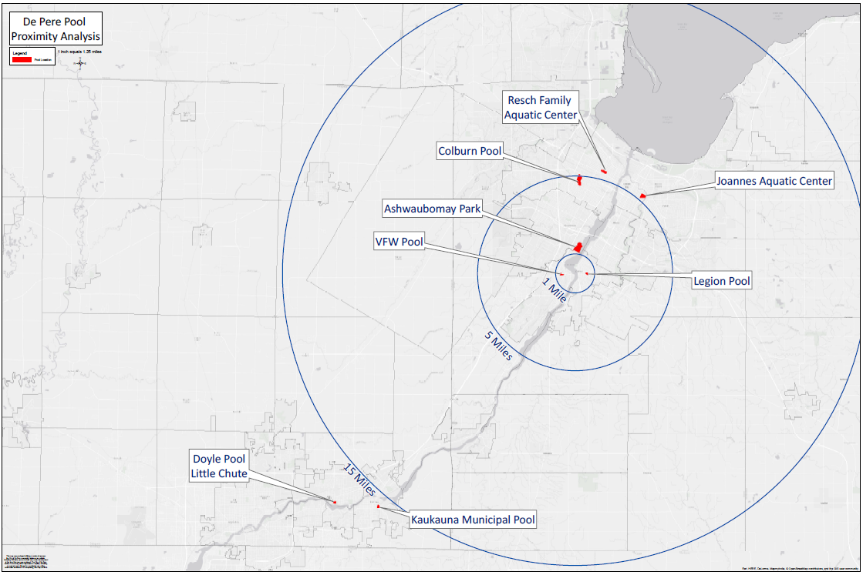
Location Map

Slide 42
Options
Keep both pools and renovate facilities “as is”.
Keep both pools and improve them to an aquatic center status.
Eliminate both pools and replace with one aquatic center.
Eliminate both pools, build one aquatic center and one splash pad.

Slide 43
Option 1 – Keep both pools and renovate facilities “as is”
Pro
Con
Keeps status quo
Likely the lowest cost of all options
Keeps “convenience” of pool facility on both sides of the river.
Facilities will not gain an “attraction”.
Life expectancy can not be accurately predicted.
High subsidy from City.
Likely to experience issues related to age of facility.

Slide 44
Option 1 – Keep both pools and renovate facilities “as is”
Projected cost would be $1 million.
Projected attendance of both pools – 29,000
Projected Budget
  Expense $250,000
  Revenue $100,000

Slide 45
Option 2 – Keep both pools and improve them to aquatic center status
Pro
Con
Maintains pools on each side of river.
Upgrades to the pool facilities become an “attraction”.
Cost
Subsidy from City would be expected to be high.
Will be tough to predict revenue and attendance as they will be competing for the same target audience.
Building improvements are limited, especially in “functionality”.
Life expectancy of building and pool are questionable, as it will depend on the level/complexity of improvements.

Slide 46
Option 2 – Keep both pools and improve them to aquatic center status
Projected cost would be $2-$3 million.
Projected attendance for both pools – 55,000.
  Basis (assumes we would have slightly greater attendance than Neenah’s one aquatic center).
Projected Budget
  Expense $400,000
  Revenue $220,000
Budget is difficult to project. Many variables (ie. Limited audience, impact of two facilities on target market, size of improvements, etc…)

Slide 47
Option 3 – Eliminate both pools and replace with one aquatic center
Pro
Brings City in-line with other comparable municipalities for number of pools per capita
Cost (Subsidy and capital costs projected to be lower)
Creates main attraction for the City.
Allows opportunity to locate aquatic center in best possible location.
Administration becomes more efficient
Vacant pool areas can be repurposed.
Con
Eliminates “neighborhood” aspect of our pool facilities.
Create longer travel distances for some of our community.
Cost

Slide 48
Option 3 – Eliminate both pools and replace with one aquatic center
Projected Cost would be $4-$5 million
  Difficult to project due to variables (ie. Size, location, amenities, etc…)
Projected attendance – 45,000
Projected Budget (projections are based on averaging Neenah and Appleton Aquatic facilities)
  Expense $200,000
  Revenue $160,000

Slide 49
Option 4 – Eliminate both pools, build one aquatic center and one splash pad
Pro
Reduces number of pools to match other comparable communities.
Allows City to address having an aquatic activity on each side of river.
Creates multiple attractions in the City.
Administration becomes more efficient.
Con
Cost
Maintenance

Slide 50
Option 4 – Eliminate both pools, build on aquatic center and one splash pad
Projected Cost would be $4.5 - $5.5 million.
  Difficult to project due to variables (size, location, amenities, etc…) Includes construction cost of Splash Pad and Aquatic Facility.
Projected attendance – 45,000 (pool)
Projected Budget
  Expense $225,000
  Revenue $160,000

Slide 51
Questions

